Slide 1



Cloud Native Workshop
Publish, Secure, & Monitor APIs with Pivotal Cloud Foundry Route Services
Pivotal Cloud Foundry
Notes:
I want to talk to you about cloud native applications, and bringing microservice architectures into production in the enterprise.

Slide 2
Agenda
Pivotal Cloud Foundry
PCF Route Services
Apigee Edge with PCF
Demo
Conclusion
Notes:
What makes this possible is the fact that we have available to us infinite amounts of inexpensive computing power and storage power. A lot of this intelligence is driven by the fact that you can throw computing power and storage resources at the problem in a way that you simply could not do before.
If you look at the disruptive companies in the world, this is exactly what they're doing. They are taking lots of information, analyzing it in real-time, adding intelligence and using modern techniques to reshape industries and construct new business models.

Slide 3







DevOps
Continuous
Delivery
Modern Platforms
Cloud Native
Microservices
Containers
Notes:
How does one become cloud native and what does it mean ? - lets dig deeper

Slide 4


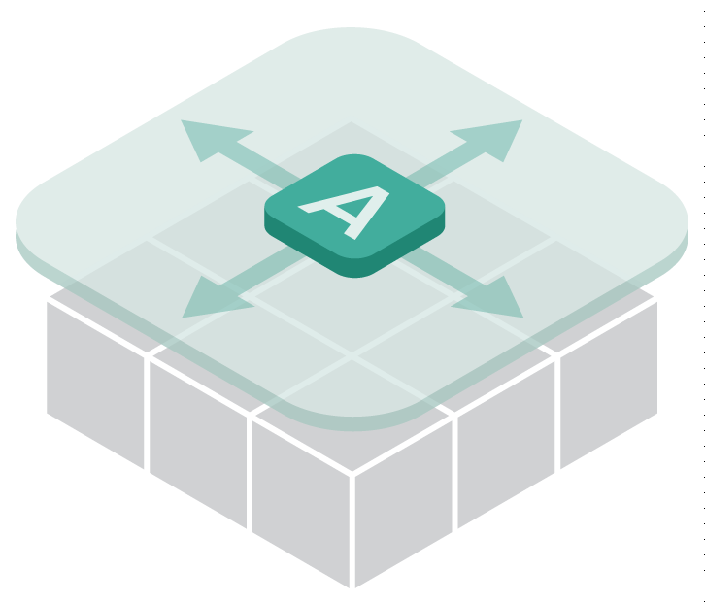






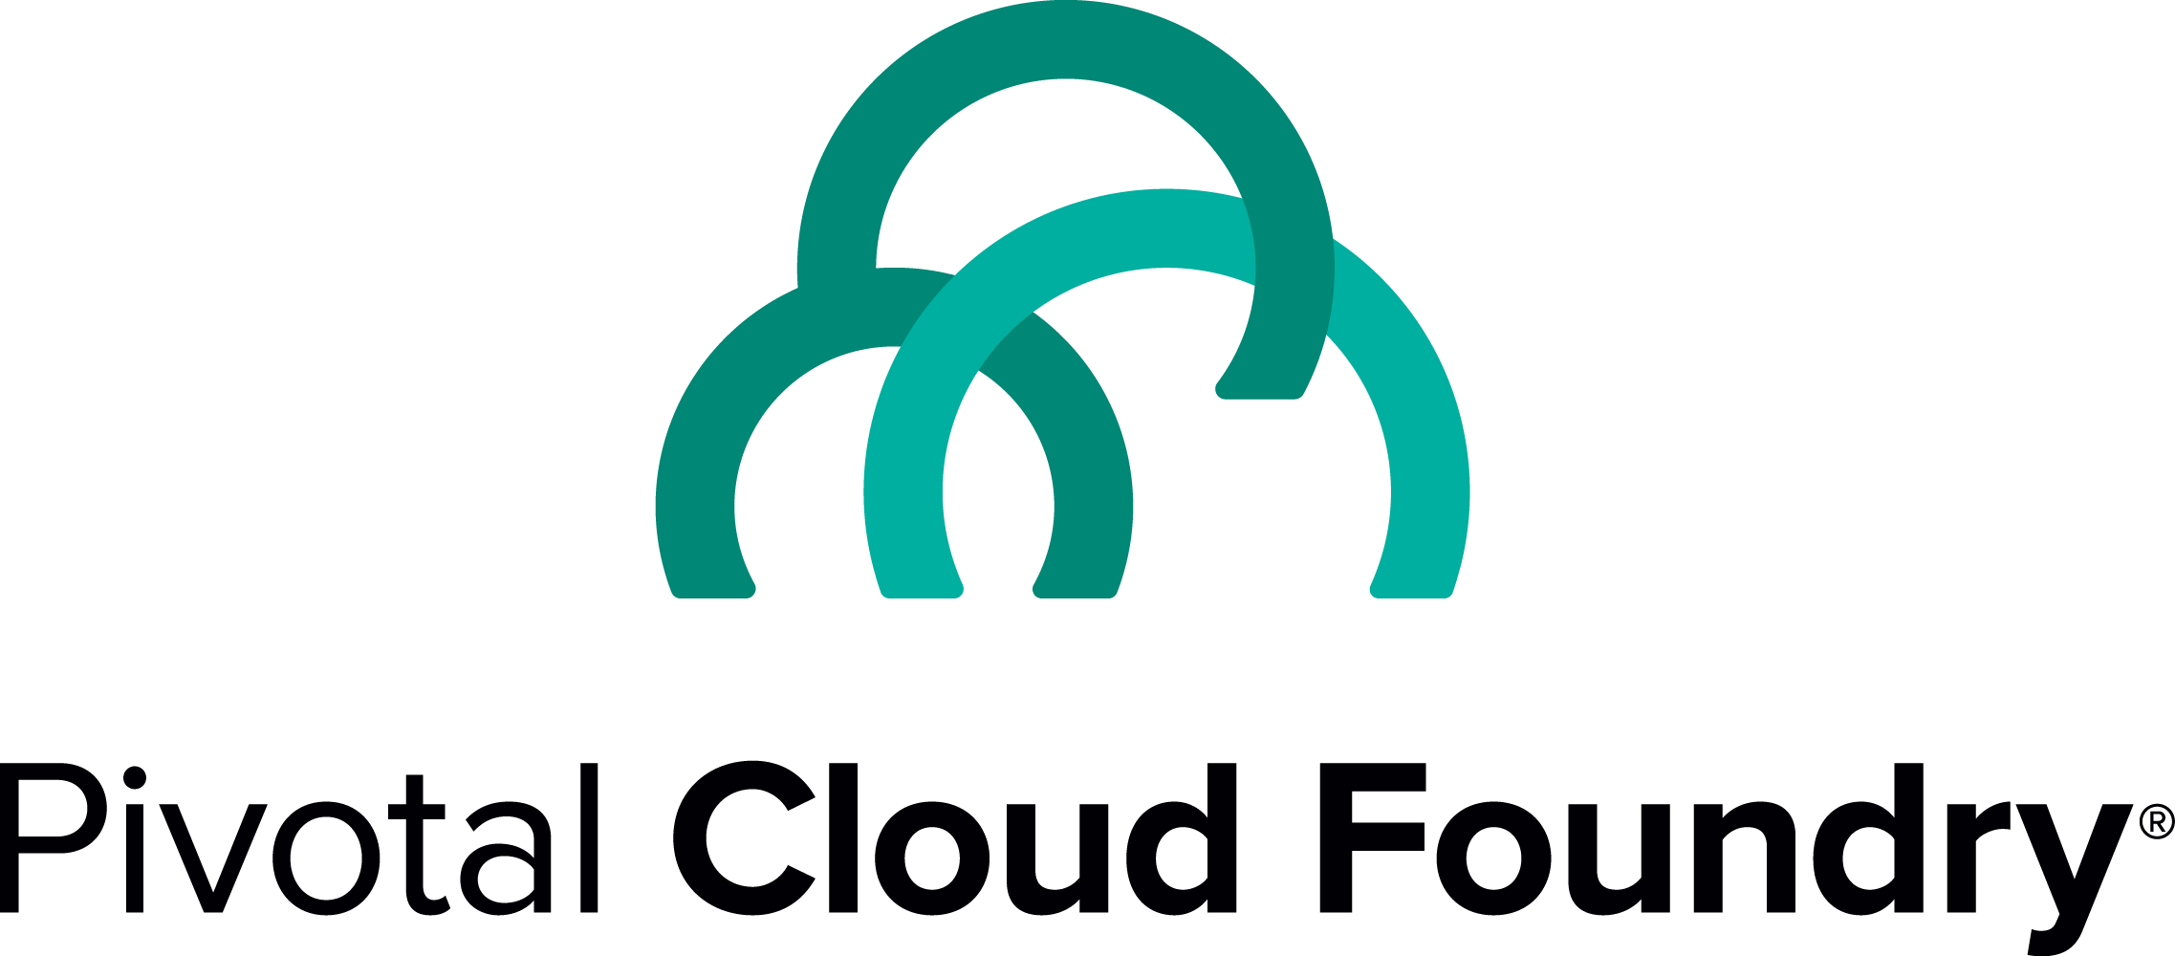
Pivotal Cloud Foundry – an API Centric Platform
Health management
Security and Isolation
Metrics
Scaling
Log Aggregation
Blue green deployment
Roles and Policy
Route Services
Notes:
Roles and Policy

Slide 5


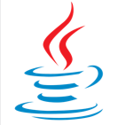








Implement APIs your way
Development Language Flexibility
>cf
Push App
http://
more…
Push your app and it just works…no “snowflakes”, no waiting.

Slide 6

Why APIs?
Simple
Universal
Every developer understands them
Notes:
There is also a set of technology that we call “API technology.”

Slide 7
The Gap : How to Scale Adoption of Software
Total Cost = (Cost of Onboarding + Cost of Management) * # of consumers of your software * Churn
Partners
Internal Businesses
Open Ecosystem
APP
APP
APP

Slide 8
Scale Adoption Of Your Software with Modern APIs
Partners
Internal Businesses
Open Ecosystem
APIs are the key enabler to building your digital platform
APP
APP
APP
Notes:
APIS enable you to scale your software

Slide 9
Agenda
Pivotal Cloud Foundry
PCF Route Services
Apigee Edge with PCF
Demo
Conclusion
Notes:
What makes this possible is the fact that we have available to us infinite amounts of inexpensive computing power and storage power. A lot of this intelligence is driven by the fact that you can throw computing power and storage resources at the problem in a way that you simply could not do before.
If you look at the disruptive companies in the world, this is exactly what they're doing. They are taking lots of information, analyzing it in real-time, adding intelligence and using modern techniques to reshape industries and construct new business models.

Slide 10
Routing in PCF
Routing in Cloud Foundry is the process by which requests to applications are forwarded to their intended destination
A dynamic routing tier is necessary because Cloud Foundry may move application instances between hosts for high availability
Developers manage the URLs their applications receive requests
Requests to Cloud Foundry system components are managed this way

Slide 11
Application Request Path in PCF
Cloud Foundry
Host
Container
myapp.cf.com/foo
8080
6001
myapp1
Client
Load Balancer
Router
myapp.cf.com/bar
Container
8080
6002
myapp1

Slide 12
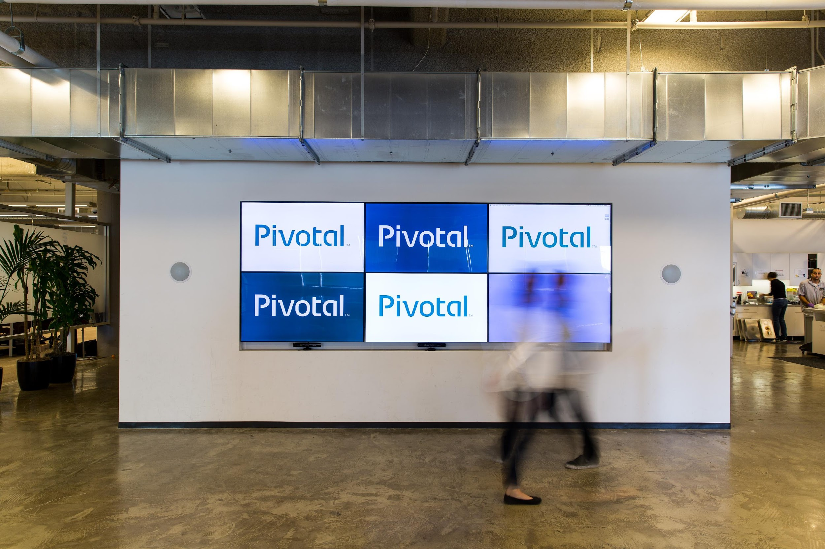
What are PCF Route Services?
A new kind of marketplace service that can be injected in the application request path
Notes:
There’s now a better way: Route Services in Pivotal Cloud Foundry (PCF). Route Services are a new type of marketplace service that developers insert into the request path for their application. These services intercept requests at the edge of PCF and help you to consistently deliver more secure, robust applications. There are three major reasons our customers wanted this functionality:
A new type of service bound to a route. GoRouter can send that information the service - filters, transformations, and send it back to the GoRouter. Route to the specific container. Communication is https. Http header is updated.

Slide 13
How are PCF Route Services used?
Ensure Performance, Reliability
Real Time Analytics, Metering
Compliance, Security,
Audit
Compliance, Security, Audit
Notes:
What business needs does route services address for our customers?
Time to market for differentiated capabilities in the realms of…
Real Time Analytics: Report on and analyze real time behavior, events based on network – level information
Compliance, Security
Performance, Reliability
How can customers get various route services, now and in the future?
From Pivotal
From Partners
From customers making their own
Increase developer velocity.
It’s all about helping developers go faster and decreasing time to market for services. Developers already take advantage of PCF-integrated services like Spring Boot to reduce the time spent coding basic scaffolding, and Route Services automate yet another part of the delivery pipeline. Instead of finishing API development, opening a ticket, and waiting for the Ops team to register it with the API Gateway, the developer can self-select the corresponding Route Service from the PCF marketplace and automatically include it as part of their app deployment.
Developers aren’t just creating new apps; they spend a lot of time evolving existing ones! Route Services can help here as well. You can build your own Route Service that handles API versions and backwards compatibility, or does data transformation/enrichment before the API request hits the target service. A developer may need to closely inspect the payloads of a troublesome service. Instead of deploying a new version of the service that stores the raw request and response body, the developer can temporarily bind to a Route Service that logs all the API traffic.
Promote (secure) standards.
Consistency matters. Every development team shouldn’t have to craft their own authentication scheme, anti-DDOS measures, audit log, caching mechanism, or API rate limiting procedure. These aspect-oriented concerns are best handled by a transparent, shared set of services that IT Operations and Information Security select.
The one-time setup of a Route Service is easy. System operators decide the optimal deployment architecture and then add the chosen Route Services to their PCF Marketplace. You end up with a catalog of hand-picked services that your operations team doesn’t have to manually configure one-by-one for each team. Now, the developer experience is entirely self-service.
Use industry-leading services.
PCF is an open platform. With Route Services, you have yet another extension point to make PCF fit your needs. Dozens of software providers are queued up to provide Route Services in your PCF marketplace. These providers offer application caching, mobile services, single sign on, application logging, and much more.

Slide 14
Operators
Developers
Notes:
Operators
Responding to individual developer needs is time consuming
Responding promptly is difficult, and requests may not be aligned with policies
We want to provide operators with solution they can put in place once, configured with policy, and enable developers to pick and choose, self-service
Developers
Features like authorization and rate limiting are common requirements in application development and operation
Currently developers must either build these features into their applications or coordinate with IT to provide them
Eliminate unnecessary development and support ticket wait-time
Automated, self-service, on-demand, integrated services

Slide 15
1. Given a compatible service, simply register the service broker
cf create-service-broker NAME USERNAME PASSWORD URL
2. Grant or revoke access to service plans per CF organization
cf enable-service-access SERVICE -p PLAN -o ORG
3. Log and audit use of services
cf curl /v2/events?q=type:audit.service_instance.create
Operators
Notes:
Operators
Responding to individual developer needs is time consuming
Responding promptly is difficult, and requests may not be aligned with policies
We want to provide operators with solution they can put in place once, configured with policy, and enable developers to pick and choose, self-service
Developers
Features like authorization and rate limiting are common requirements in application development and operation
Currently developers must either build these features into their applications or coordinate with IT to provide them
Eliminate unnecessary development and support ticket wait-time
Automated, self-service, on-demand, integrated services

Slide 16
1.) Discover service in marketplace
cf marketplace
2.) Create a CUPS or a Marketplace service
cf create-user-provided-service SERVICE_INSTANCE -r ROUTE_SERVICE_URL
or
cf create-service SERVICE PLAN SERVICE_INSTANCE
3.) Bind Routing Service to the Route
cf bind-route-service DOMAIN --hostname HOST SERVICE_INSTANCE
Developers
Notes:
Operators
Responding to individual developer needs is time consuming
Responding promptly is difficult, and requests may not be aligned with policies
We want to provide operators with solution they can put in place once, configured with policy, and enable developers to pick and choose, self-service
Developers
Features like authorization and rate limiting are common requirements in application development and operation
Currently developers must either build these features into their applications or coordinate with IT to provide them
Eliminate unnecessary development and support ticket wait-time
Automated, self-service, on-demand, integrated services

Slide 17






How Route Services work
Simple
Dynamic
Route Services
Service
Broker
Service
Broker
Client
Route Services
Gorouter
App
Client
Gorouter
App
Notes:
(LEFT) Simplest model for RS integration in which all HTTP requests to CF are intercepted. RS does some transformation on the Request and forwards it to the Gorouter. Broker enables developer configuration.
(RIGHT) More dynamic integration enables only requests for a particular route to be proxied to the RS, before being returned to Gorouter. Enables dynamic integration of services operated by 3rd parties. Broker enables developer configuration (and/or provisioning). When Gorouter receives the request from the route service, it uses an encrypted header to determine the request has already been sent to the RS, and forwards the request to the app.

Slide 18

Who offers Route Services for PCF?
How can I obtain Route Services?
- DIY
- Vendors

Slide 19


Apigee Edge as a PCF Route Service
Apigee
Service Broker
Route Service
Client
Gorouter
App

Slide 20
Agenda
Pivotal Cloud Foundry
PCF Route Services
Apigee Edge with PCF
Demo
Conclusion
Notes:
What makes this possible is the fact that we have available to us infinite amounts of inexpensive computing power and storage power. A lot of this intelligence is driven by the fact that you can throw computing power and storage resources at the problem in a way that you simply could not do before.
If you look at the disruptive companies in the world, this is exactly what they're doing. They are taking lots of information, analyzing it in real-time, adding intelligence and using modern techniques to reshape industries and construct new business models.

Slide 21

What is API Management?
Notes:
API decompositions of monolith application

Slide 22

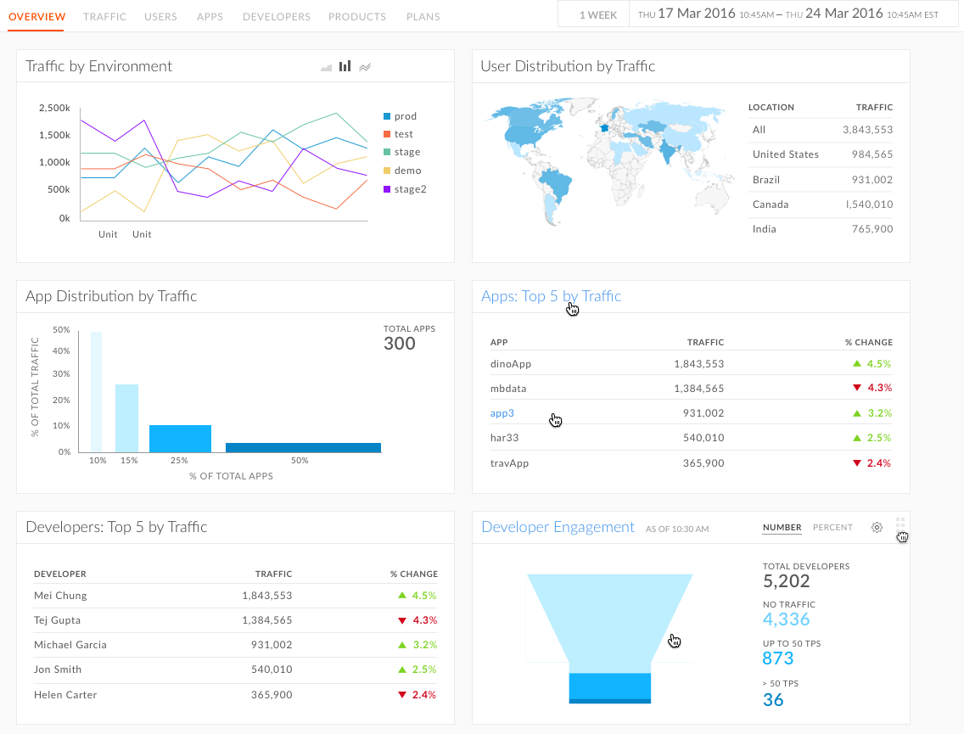
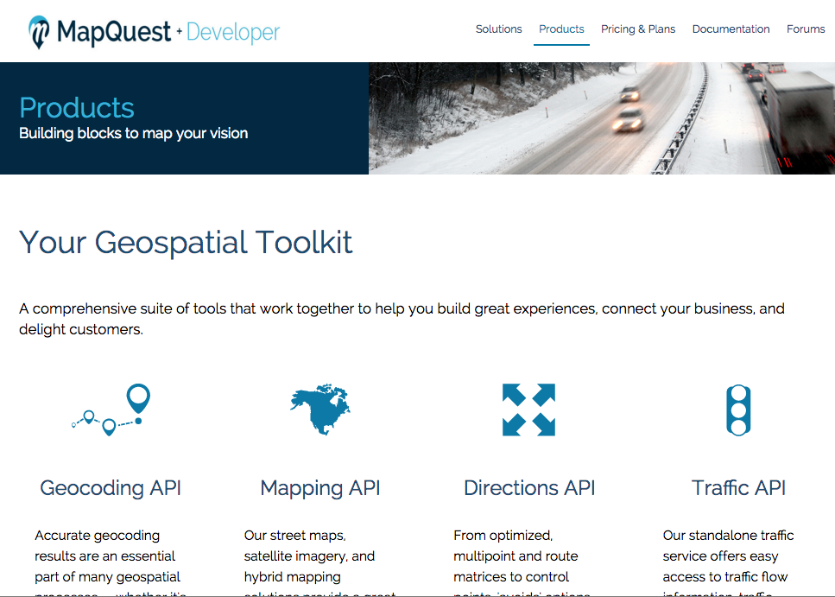

Scalable Adoption Needs API Management
Security
Partner Apps
Developers
APP
APP
Visibility / Analytics
Developer Portal
APP

Slide 23
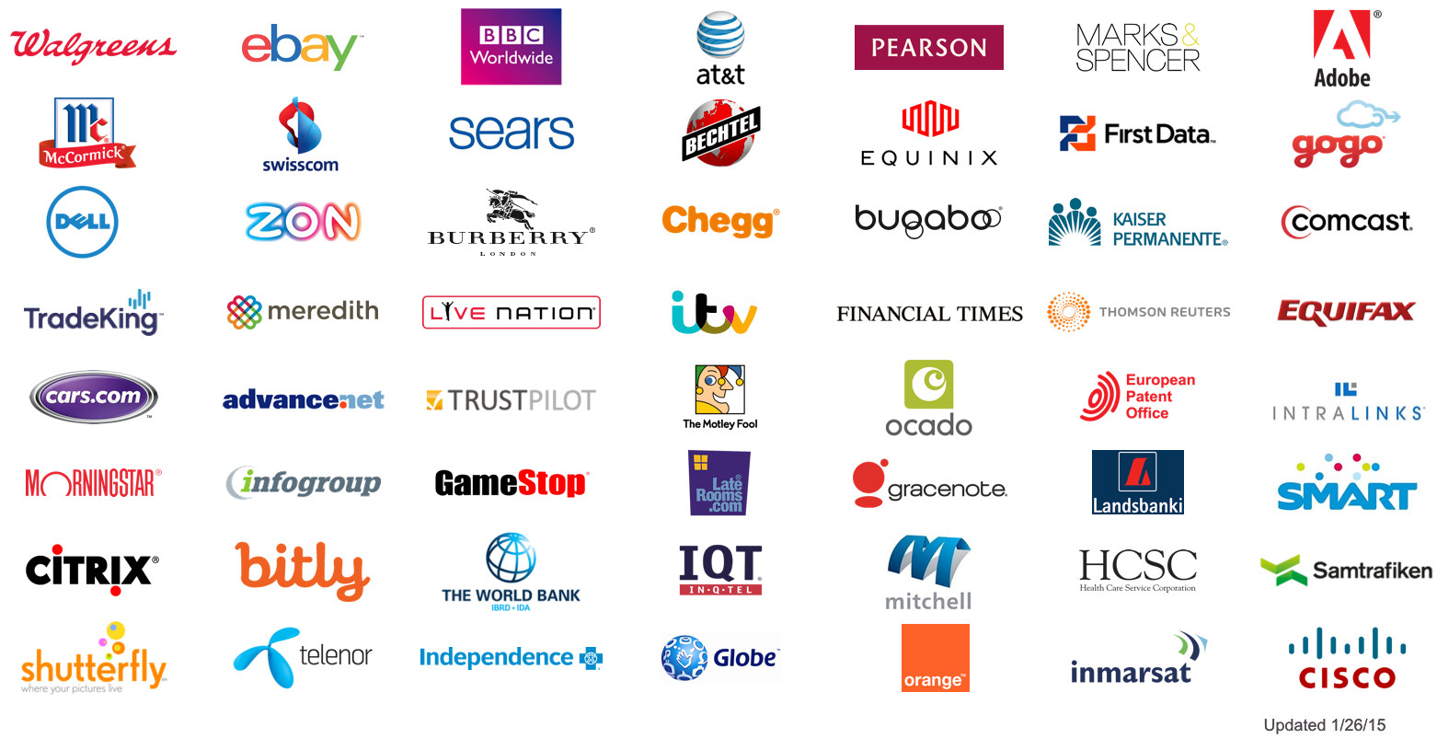
Apigee Enables Hundreds of Enterprises

Slide 24
Seamless API Management with Apigee
3
Apigee automatically creates API proxy, policies are applied and APIs can be published to Developer portal
API Proxy (Route Service)
Apigee Management API
All requests automatically routed to Apigee for security, analytics and traffic management
4
1
Install Apigee Tile from CF marketplace & create Apigee Edge service
Apigee Service Broker
Load Balancer/ Router
YOUR APP
App Clients or Partner Apps
Bind route service for your app to Apigee
2

Slide 25

DEMO
+

Slide 26
APIs: Building Blocks for Modern Apps
Partners / Developers
API MANAGEMENT
Grow Thriving Ecosystem
CLOUD NATIVE
PLATFORM
Build Great Software
Your App Developers

Slide 27



